Slide 1
Neural Networks
An Introduction

Slide 2
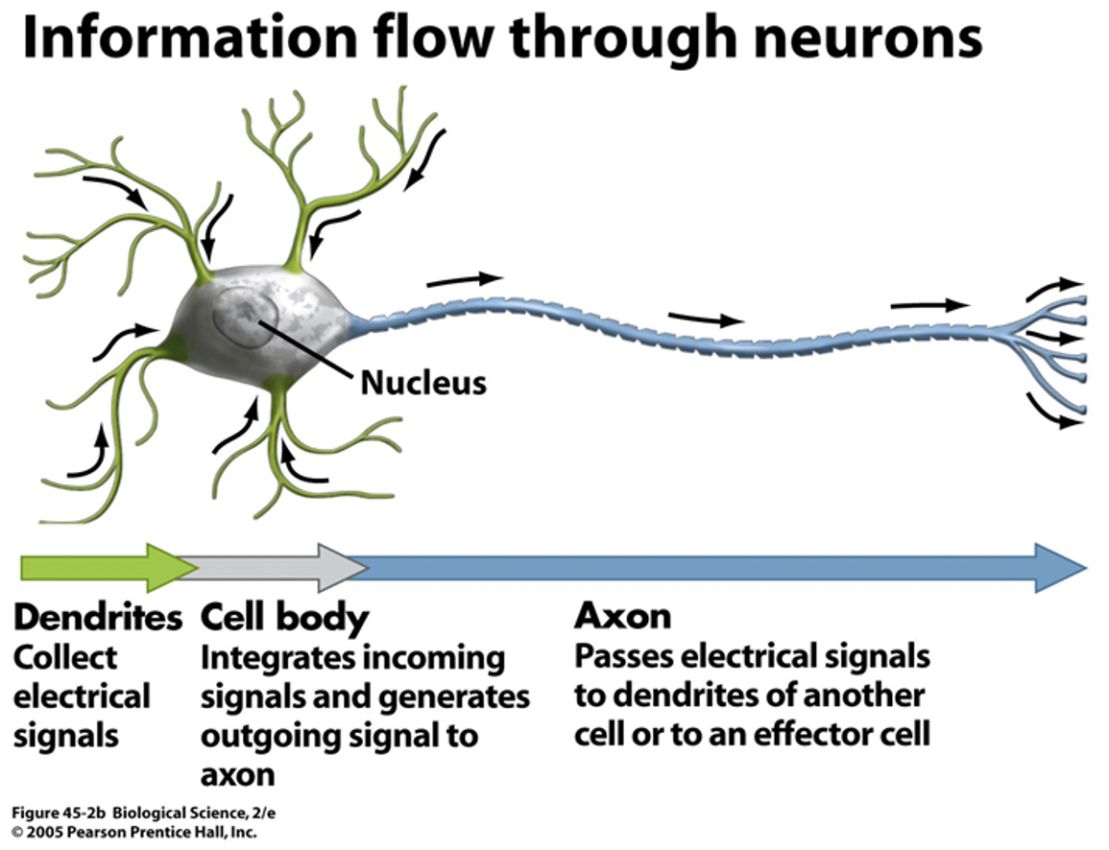
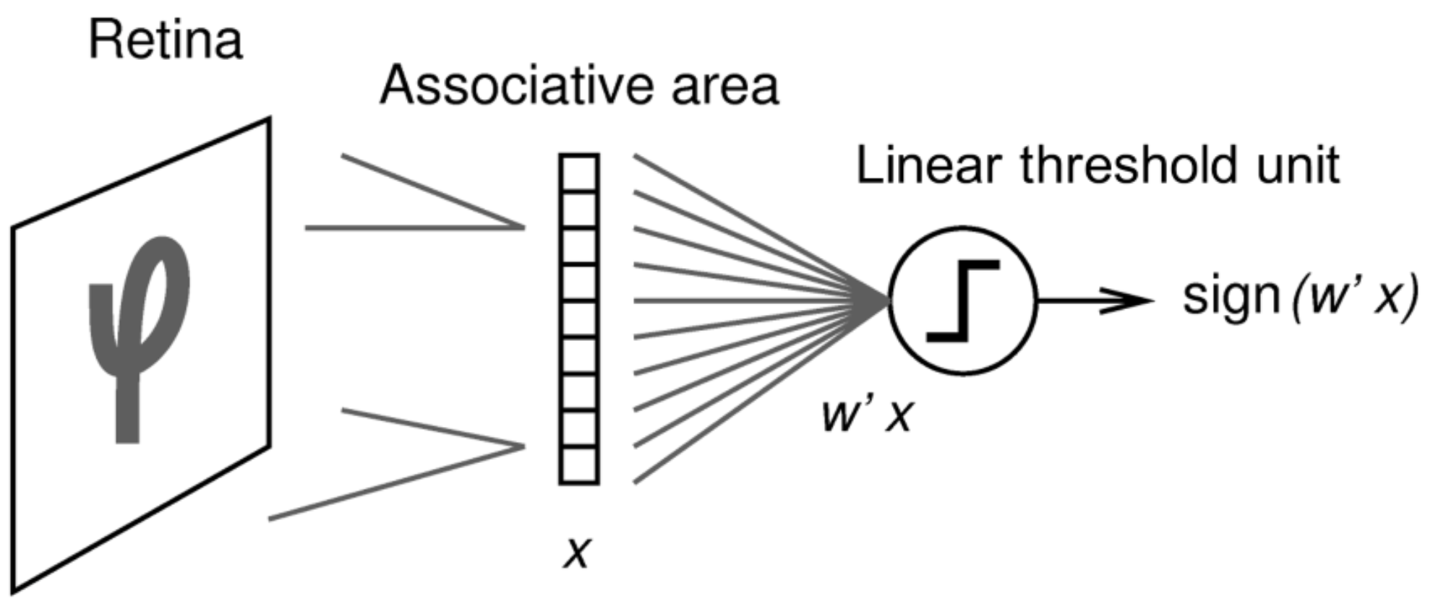
Neural Networks
All started in 1957 (F. Rosenblatt) with the “Mark I Perceptron”: the goal was to automatically detect capital letters.
https://news.cornell.edu/stories/2019/09/professors-perceptron-paved-way-ai-60-years-too-soon

Slide 3
Neural Networks and Deep Learning
The main idea is to replicate the mechanism of vision/sensorial perception from the brain of living organisms. One of the seminal papers for neural networks (Hubel & Wiesel 1962) tried to explain the vision mechanism in the cat’s brain:
Hubel, D. H.; Wiesel, T. N. (1962). “Receptive fields, binocular interaction and functional architecture in the cat’s visual cortex”. The Journal of Physiology. 160 (45): 106–154. doi:10.1113/jphysiol.1962.sp006837.

Slide 4
History of Development
Neural Networks have been a success for computer vision, image analysis and classification problems; however we can use the method for regression, as well.
• It was able to identify capital letters.
• From 1960 - 1986, things progressed relatively slowly.
• D. Rumelhart, G. Hinton and R. Williams were able to achieve the first back-propagation network (Seminal paper “Learning Representations by back-propagating errors” Nature Vol. 323, 1986 ).
• 1990, P. Werbos, “Backpropagation Through Time: What It Does and How to Do It”
• G. Hinton and R. Salakhutdinov examined the capability of neural nets for image recognition in 2006. Explosive research into neural nets from 2006 - today.

Slide 5
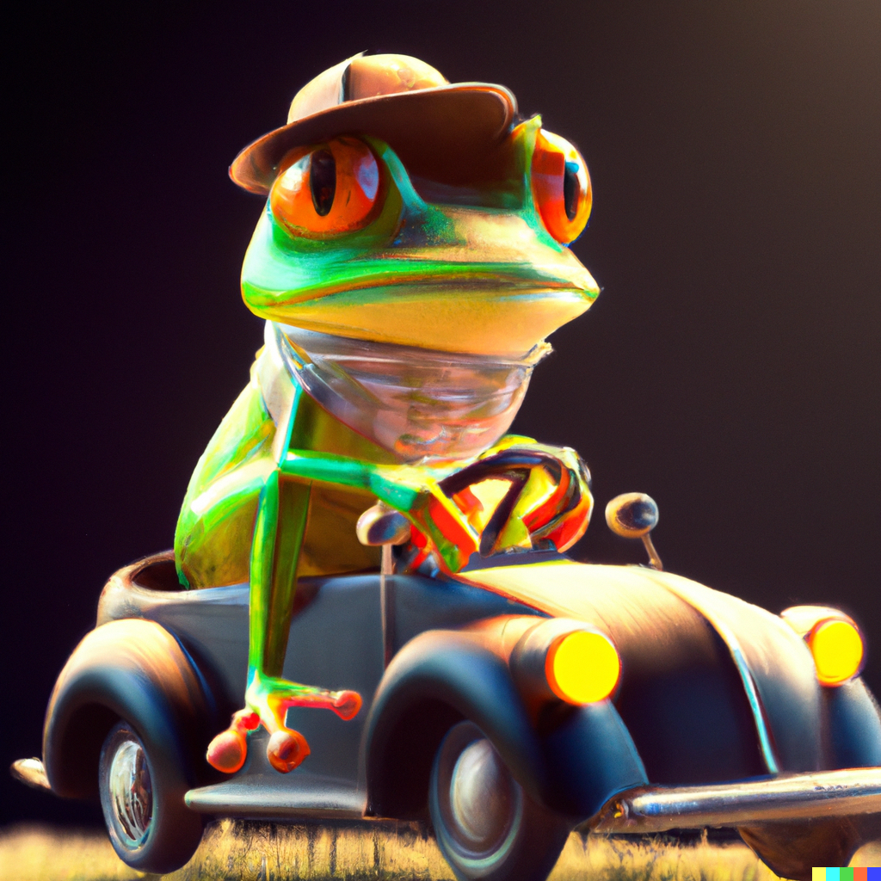
Nature Inspired Design
Species | # of Neurons
ant | 250 K
bee | 960 K
frog | 16 M
rat | 200 M
cat | 760 M
owl | 1 B
dog | 2.8 B
lion | 4.7 B
monkey | 30 B
human | 86 B
Fun Fact: A frog has enough neurons to learn how to drive your car, but if it did, it would occupy its entire memory and it would not know how to feed itself.

Slide 6
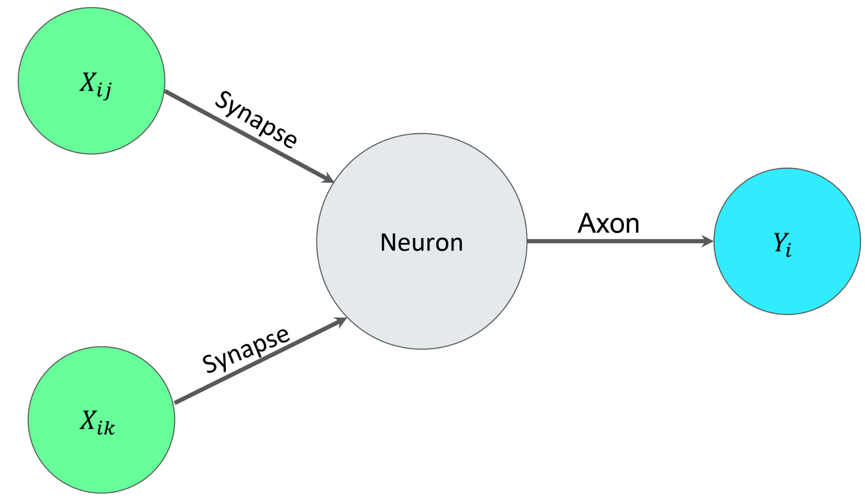
The Artificial Neuron

Slide 7
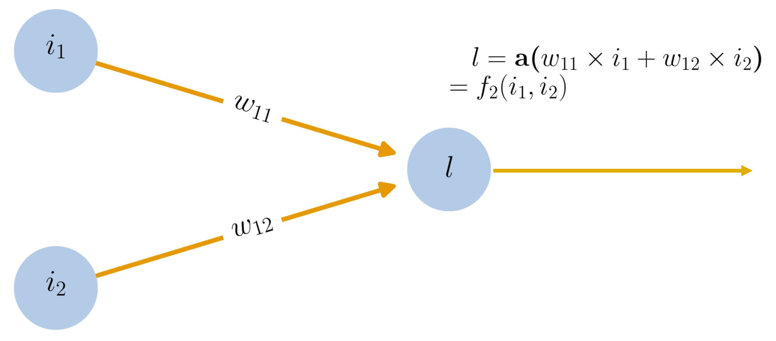
The Artificial Neuron
An artificial neuron computes a weighted combination of input values followed by an activation function.

Slide 8
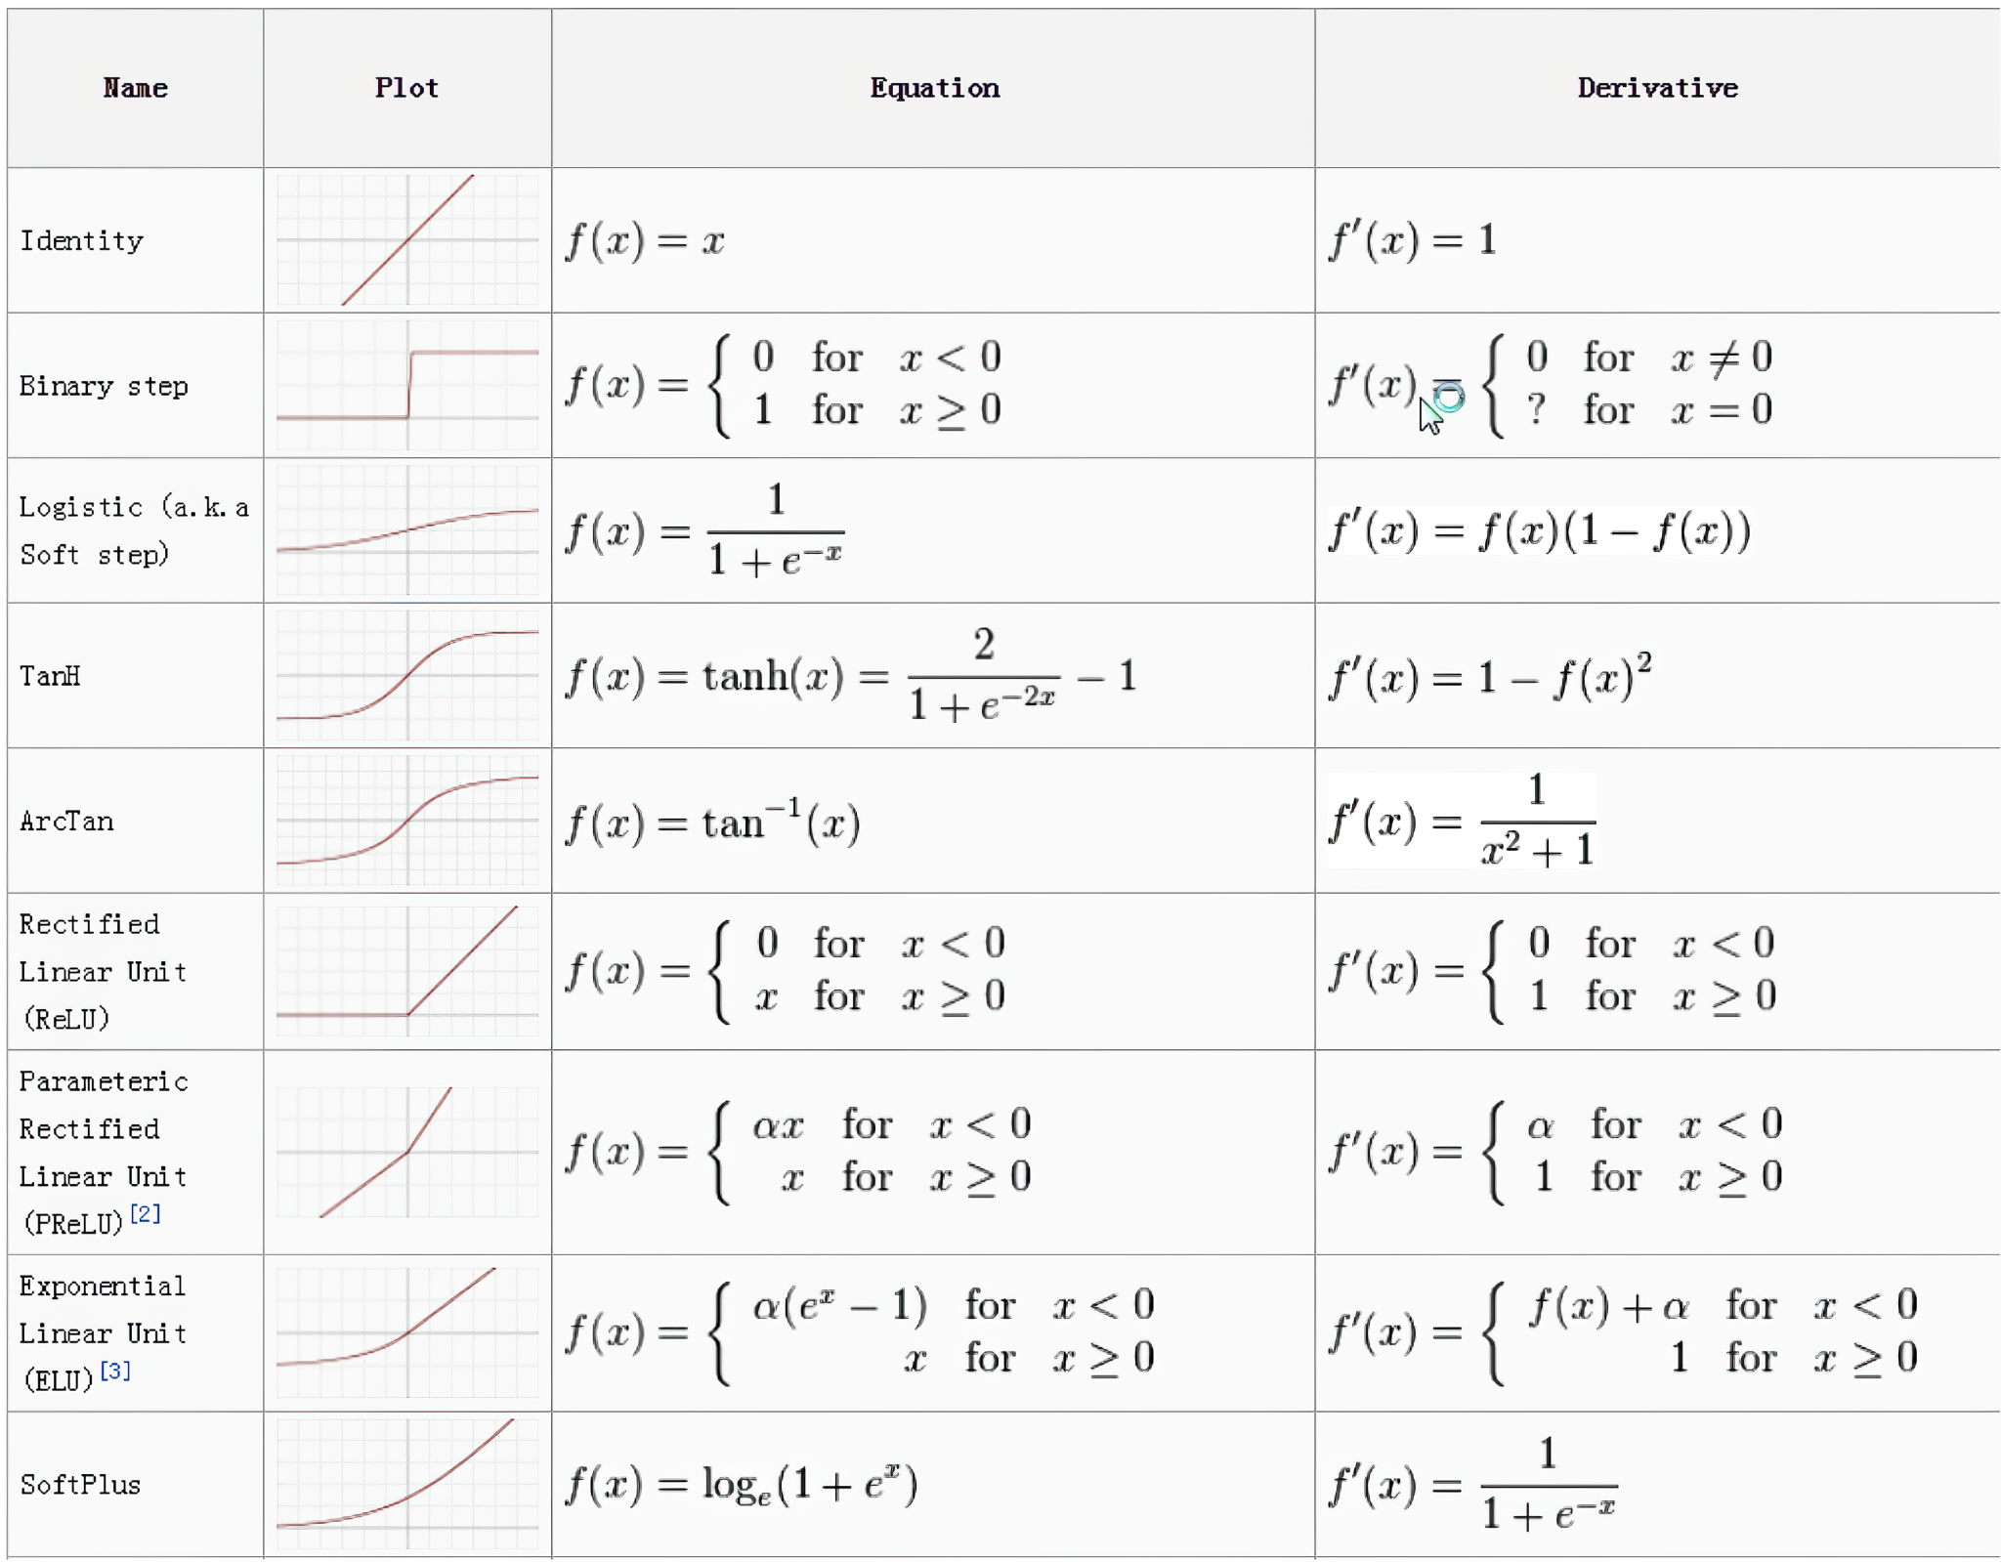
Activator Functions
For creating Neural Nets we prefer libraries that are hardware efficient, such as Torch or Tensorflow.
Activation functions in Tensorflow include:
ReLu, LeakyRelu, GeLU, SeLU, SoftMax, Sigmoid, Tanh, Hard Sigmoid, Swish.

Slide 9
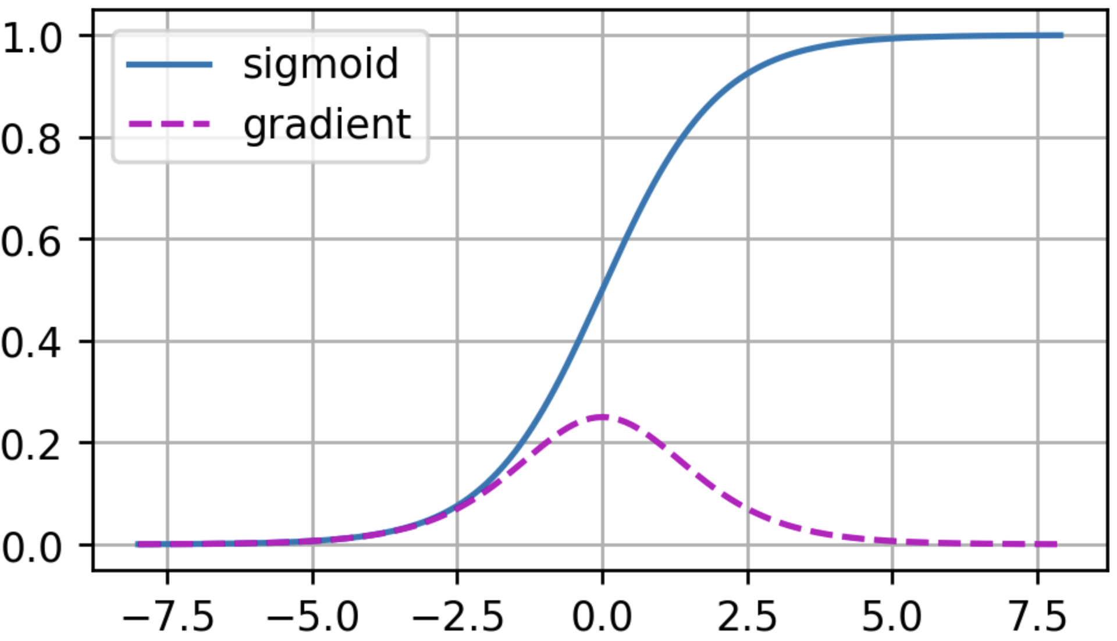
Possible Problems: Vanishing Gradient

Slide 10
Machine Learning & AI
Fun interactive example (design your simple neural network):
A Neural Network Playground
Important: what exactly is the machine learning, and how exactly is learning?
Answer: the machine is learning weights, probabilities and numbers via backpropagation algorithms.
https://torontolife.com/tech/ai-superstars-google-facebook-apple-studied-guy/

Slide 11
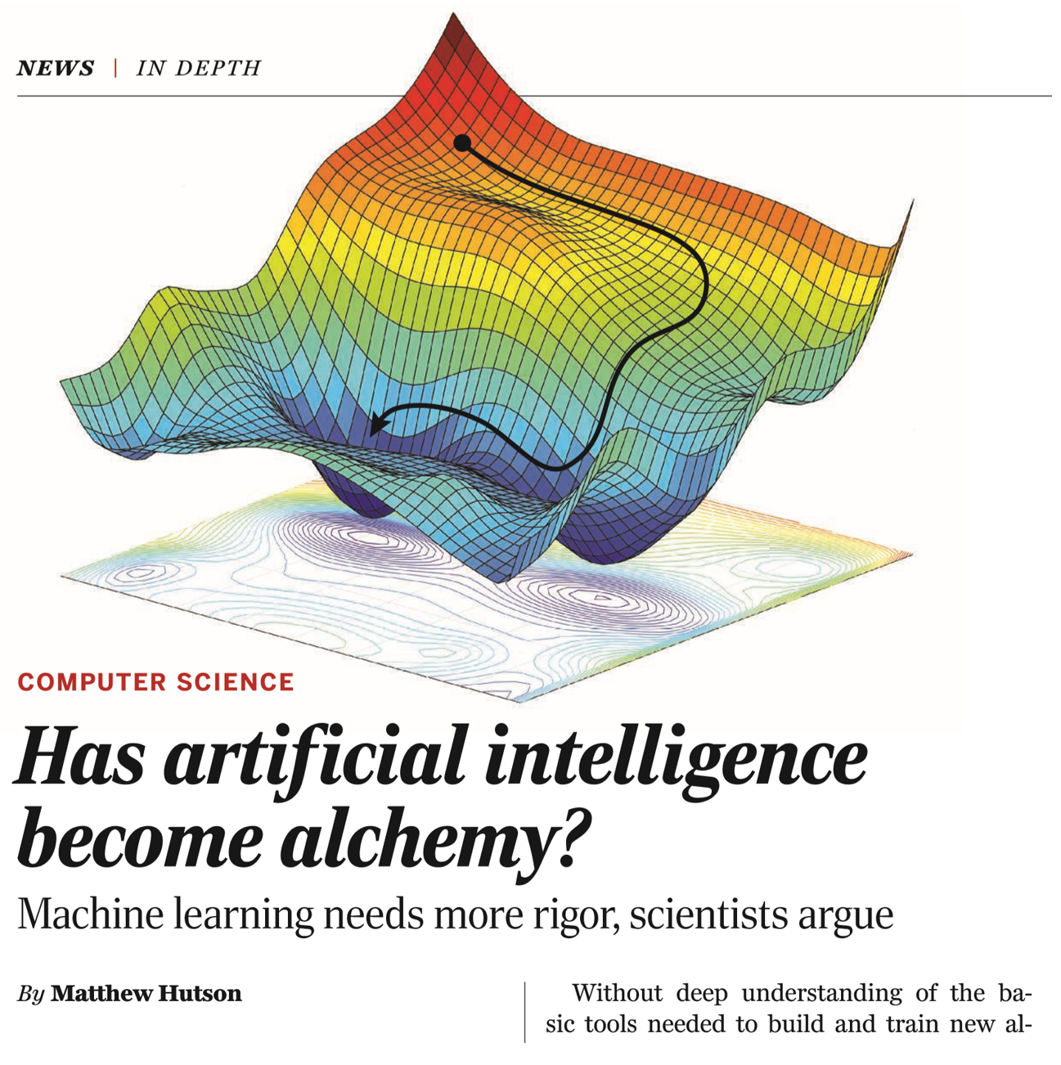
Main Criticism
https://www.science.org/content/article/ai-researchers-allege-machine-learning-alchemy

